Slide 1




Office Employees Data Analysis Source: : https://github.com/PacktPublishing/50- Hours-of-Big-Data-PySpark-AWS-Scala-andScraping/tree/main/Part%203/Code/03- Spark%20DFs Dataset: Variety-wise Daily Market Prices Data of Commodity Email: k.h.s.bharadwaj123@gmail.com Phone : 9701095575 LinkedIn : https://www.linkedin.com/in/bharadwajkollepara/
Employees Dataset Analysis Using PySpark
Bharadwaj Kollepara

Slide 2
Introduction
This presentation provides an analysis of the Office Employees data, covering:
- Structure and Uniqueness
- Departmental Distribution
- State-wise Representation
- Salary Insights
- Age Distribution
- Bonus Patterns
- Workforce Characteristics

Slide 3
Initial Analysis of the Dataset
The dataset provided contains details of 1,000 employees across different departments and states in a company. It has seven columns: employee_id, employee_name, department, state, salary, age, and bonus. There are no missing values, ensuring data consistency and completeness, which is an advantage for any analysis. Below are the detailed insights:
1. Structure and Uniqueness
The dataset comprises 1,000 rows and 7 columns. Each employee is uniquely identified by an employee_id. While employee_name has 939 unique entries, there are a few repeated names, possibly due to either duplicate naming or different employees sharing the same name. Departments are categorized into six unique groups, and employees belong to five different states. This indicates the dataset captures a fairly distributed yet compact workforce spread across multiple regions.
2. Departmental Distribution
There are six departments represented in the dataset, with HR being the largest department, employing 171 individuals. Other departments such as Marketing, Finance, Accounts, and Purchasing also have significant representation. The spread across departments reflects a balanced organizational structure where no single department is disproportionately dominant, although HR stands out slightly. Such distribution is important to analyze workforce allocation and departmental budgeting.

Slide 4
Initial Analysis of the Dataset
3. State-wise Representation
Employees are located across five states, with Alaska (AK) being the most represented state with 209 employees. This suggests either a concentration of company operations in Alaska or the presence of a major office/branch there. California (CA) also has a notable presence, likely due to its role as a business hub. A geographic spread across multiple states indicates regional diversity, which may impact payroll, compliance, and workforce policies.
4. Salary Insights
The salary variable exhibits a wide range, from a minimum of 1,006 to a maximum of 9,985. The average salary is approximately 5,330, with a standard deviation of around 2,603, reflecting high variation in employee earnings. The median salary of 5,188 is close to the mean, suggesting that the distribution is fairly symmetrical but with some higher outliers. Salaries are aligned with age and department, where senior roles or specific departments may command higher pay.
The interquartile range (IQR) of salaries (3,095 – 7,614) shows that 50% of employees fall within this range, indicating a moderate pay scale across the organization. Outliers with very high salaries may represent top-level executives or highly specialized roles.

Slide 5
Initial Analysis of the Dataset
5. Age Distribution
The workforce has an age range between 20 and 50 years, with an average age of 35.3 years. This suggests a predominantly mid-career employee base, balancing both young professionals and experienced staff. The 25th percentile age is 28, while the 75th percentile is 43, indicating that most employees fall in the late-20s to early-40s bracket. A younger workforce may suggest high adaptability, while a balanced mix with experienced staff ensures organizational stability.
6. Bonus Patterns
Bonuses range between 500 and 2,000, with an average bonus of 1,253. This demonstrates a structured incentive system across employees. The median bonus is 1,245, closely aligned with the mean, indicating fairness and consistency in distribution. The standard deviation of 433 suggests moderate variability, implying performance-based bonuses rather than uniform allocations. Departments with high performers or revenue-generating functions (e.g., Marketing, Finance) may likely enjoy higher bonuses.

Slide 6
Initial Analysis of the Dataset
7. Key Relationships
Age vs. Salary: Older employees are generally expected to earn higher salaries due to experience. Given the dataset’s salary spread, this likely holds true.
Department vs. Bonus: Bonuses may correlate with revenue contribution. For instance, employees in Marketing and Finance might earn higher incentives compared to support functions like HR.
State vs. Salary: Regional cost of living and company branch size might influence salaries. States with higher employee counts, like Alaska and California, could show salary variations.
8. Workforce Characteristics
Overall, the company exhibits a diverse workforce in terms of geography, age, and pay structure. The absence of missing data makes this dataset reliable for predictive modeling, HR analytics, and workforce planning. It also highlights organizational priorities, such as a strong HR department and fair bonus allocation.

Slide 7
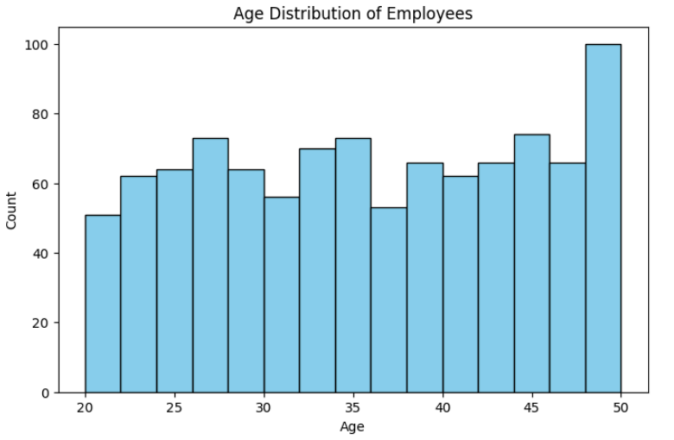
Age Distribution Of Employees in Office
This line plot highlights employee age frequencies, showing workforce concentration in specific age brackets, useful for understanding demographic patterns and potential training, hiring, or retirement planning needs within the organization.

Slide 8
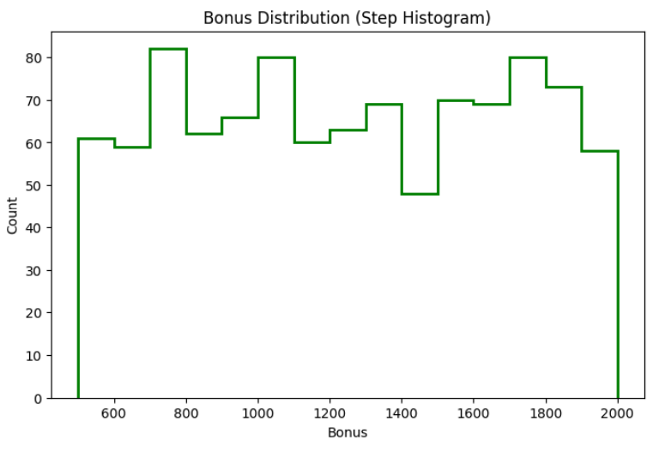
Bonus Distribution of Employees in Office
This step histogram displays bonus frequency across employees, highlighting whether most workers receive smaller or larger incentives. It helps assess bonus fairness, identify performance-driven disparities, and support compensation policy evaluations.

Slide 9
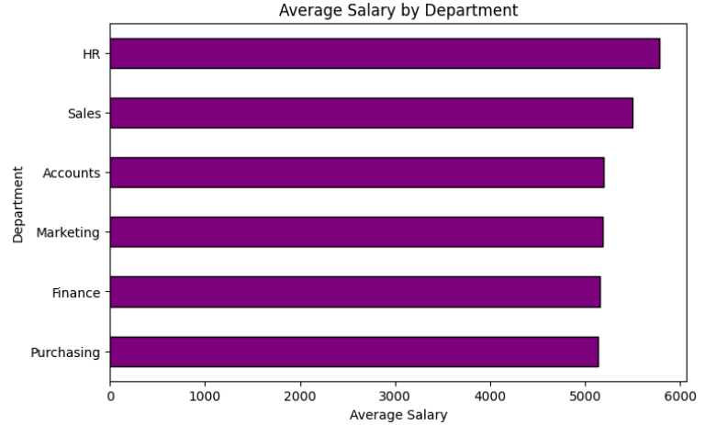
Average Salary of Employees by Department
The horizontal bar chart compares average salaries across departments, showing pay differences. It highlights high-paying divisions and lower-paid ones, guiding HR and management on equity, budgeting, and retention strategies effectively.

Slide 10
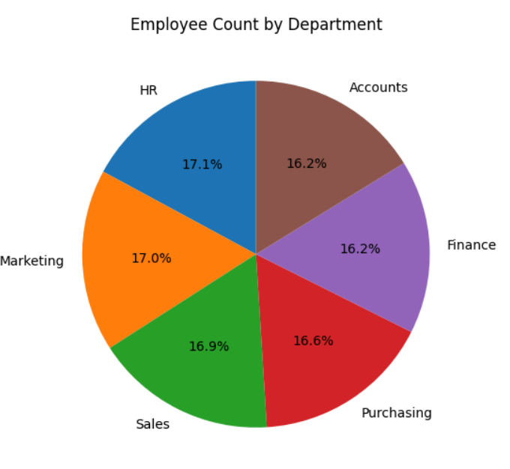
Employee Count By Department
The pie chart shows departmental workforce distribution. Larger slices represent heavily staffed departments, while smaller ones indicate leaner teams, helping in assessing resource allocation, organizational balance, and recruitment planning needs.

Slide 11
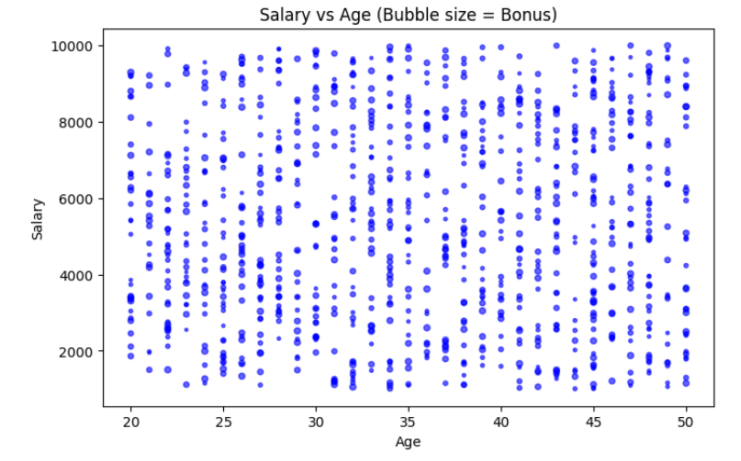
Salary vs Age of Employees
This bubble chart compares employee age and salary, with bubble sizes representing bonuses. It reveals correlations between age, pay, and incentives, helping identify experience-reward alignment and performance-based compensation trends.

Slide 12
Dataset Observation
Age Distribution
The workforce is spread across various ages, but most employees fall within the 25–40 age range, indicating a younger to mid-career dominant staff profile.
Employees above 45 years are fewer, suggesting limited senior-level representation or higher attrition at older ages.
Salary Insights
Salaries are concentrated around certain ranges, with mid-level salaries being most frequent.
A few high salaries exist, indicating possible managerial or executive roles.
Some departments show considerable pay disparities, hinting at skill-based or role-specific differences.

Slide 13
Dataset Observation
Bonus Distribution
Bonus amounts vary widely, with most employees receiving modest bonuses.
Certain departments or individuals receive significantly higher bonuses, likely linked to performance-based incentive policies.
Departmental Trends
Some departments employ significantly more staff, suggesting a heavier operational workload or core business function.
Departments differ in salary and bonus levels, reflecting varied strategic importance or skill demand.
Geographical Distribution (State)
Employee concentration is uneven across states, with a few states hosting larger clusters.
Smaller states or regions have limited workforce presence, likely satellite offices or specialized teams.

Slide 14
Conclusion
This dataset paints a picture of a mid-sized, geographically distributed company with a balanced age structure and fair compensation practices. Salaries and bonuses show structured variation, ensuring both competitiveness and fairness. With Alaska and HR holding a significant share, further analysis could help determine if this reflects business strategy or operational necessity. The dataset is well-suited for HR analytics, compensation planning, and workforce diversity studies.

